Slide 1

Credit Card Prediction
Analysing Credit Card Details of the user to check whether the account is Risky or not.
By - Diwakar Singh
Profile – Machine Learning Intern Batch Name: MIP-ML-09

Slide 2

Problems Statement
The primary objective of this project is to predict the approval or rejection of credit card applications. The challenge lies in understanding the key factors influencing credit card approval decisions and building a predictive model to assist in the decision-making procsss.

Slide 3
Exploratory Data Analysis (EDA)
Project
Feature Engineering
Data Preprocessing
Objectives
ML Model Development
Model Evaluation
Predicting Credit Card Approval
Recommendations

Slide 4
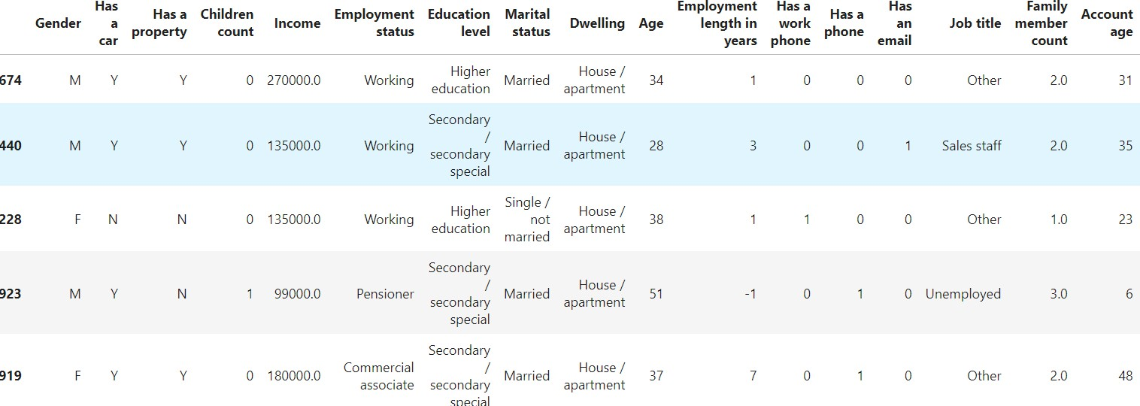
Data Exploration...
The very First step of Data Analysis: Viewing the data and finding the obvious patterns, and visualizing how out data actually looks like, how can use it to get good results.

Slide 5
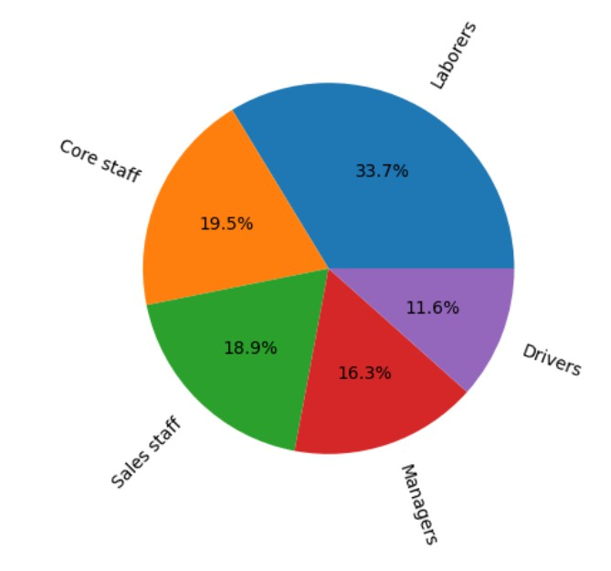
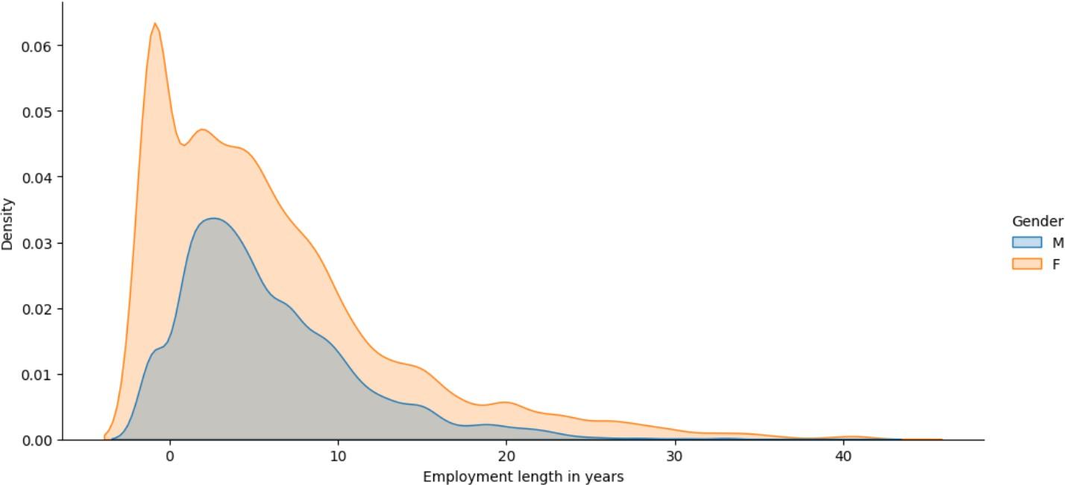
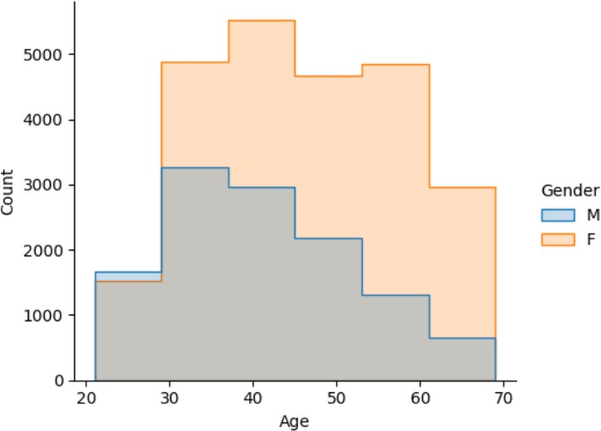
Exploratory Data Analysis (EDA)
Analysis of Data using Visual Representation of Graphs, finding trends and patterns in the data.

Slide 6
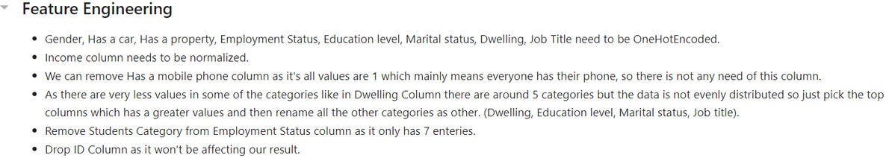
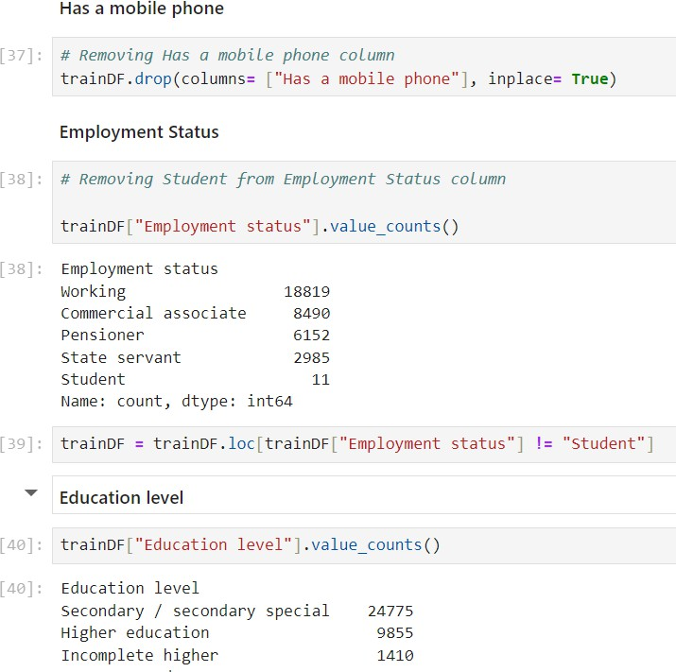
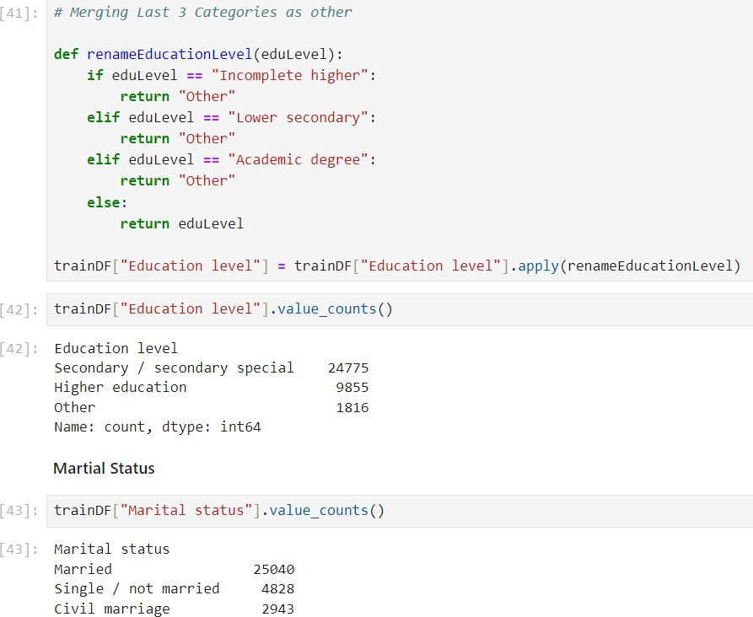
Feature Engineering
Feature engineering is shaping raw data into features that power machine learning models.

Slide 7

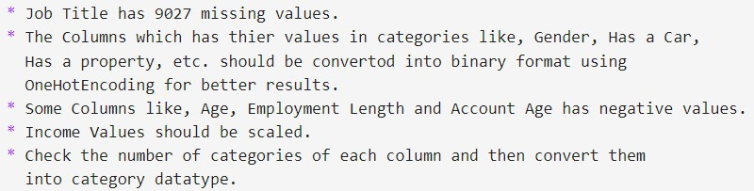
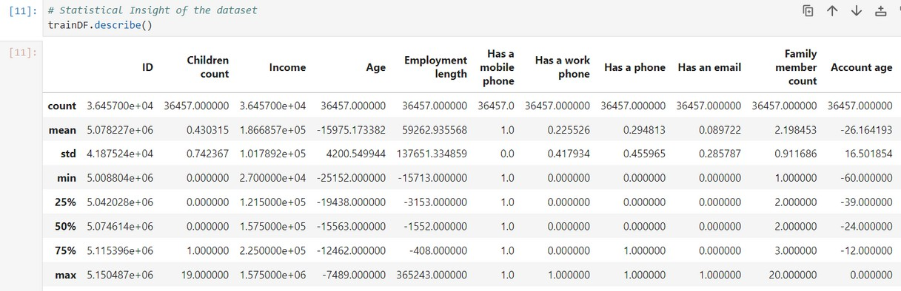
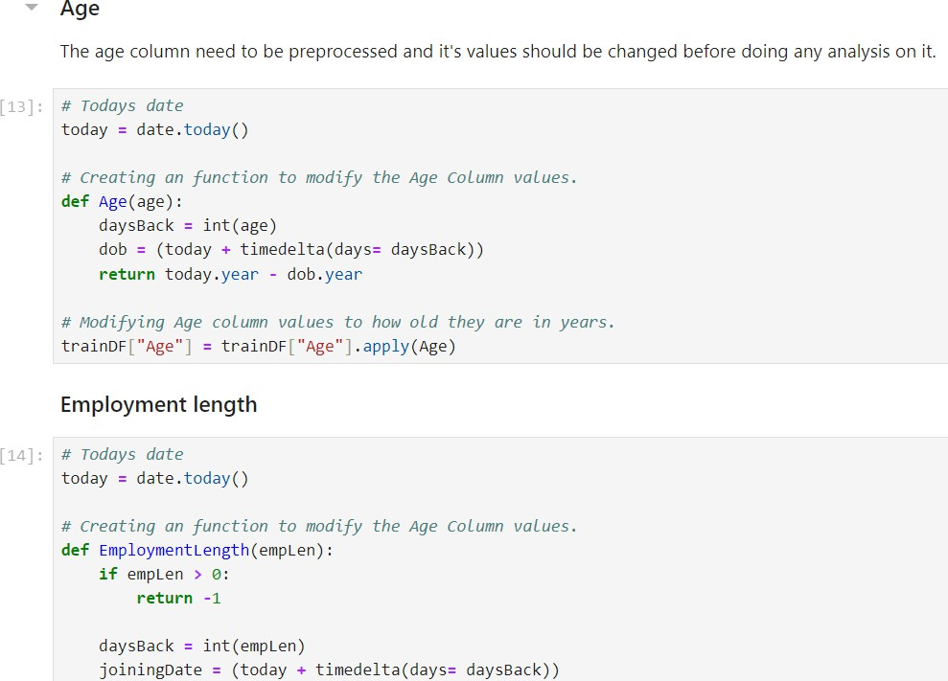
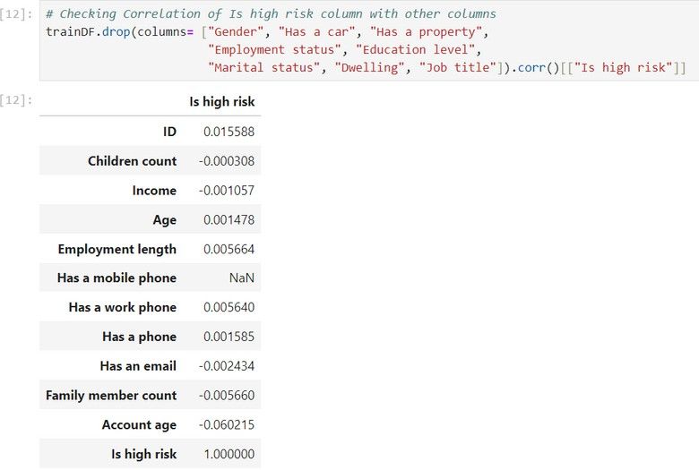
Data Pre-Processing
Data preprocessing is cleaning and preparing raw data for machine learning algorithms.

Slide 8
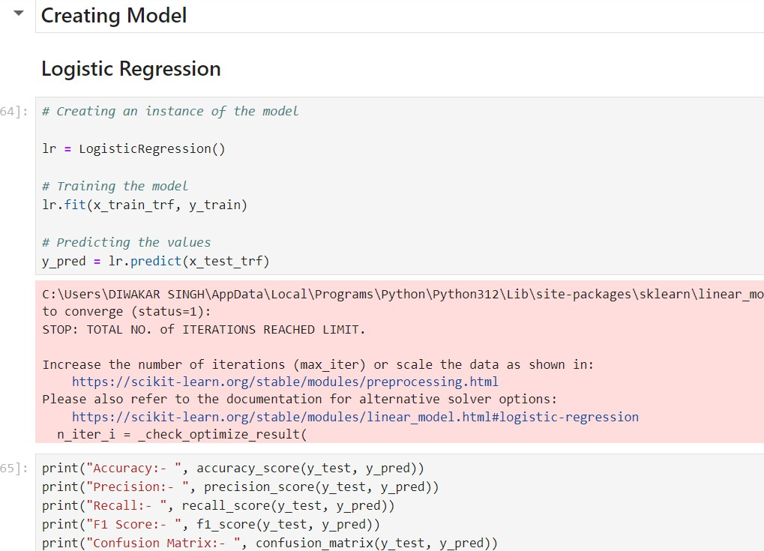
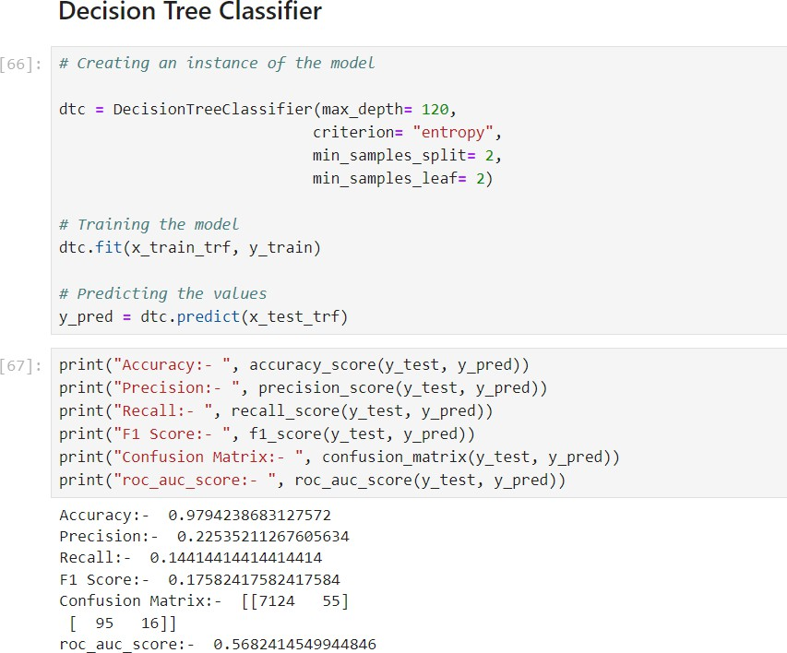
ML Model Development
ML development = Turning data into knowledge through feature engineering, model training, and evaluation.

Slide 9
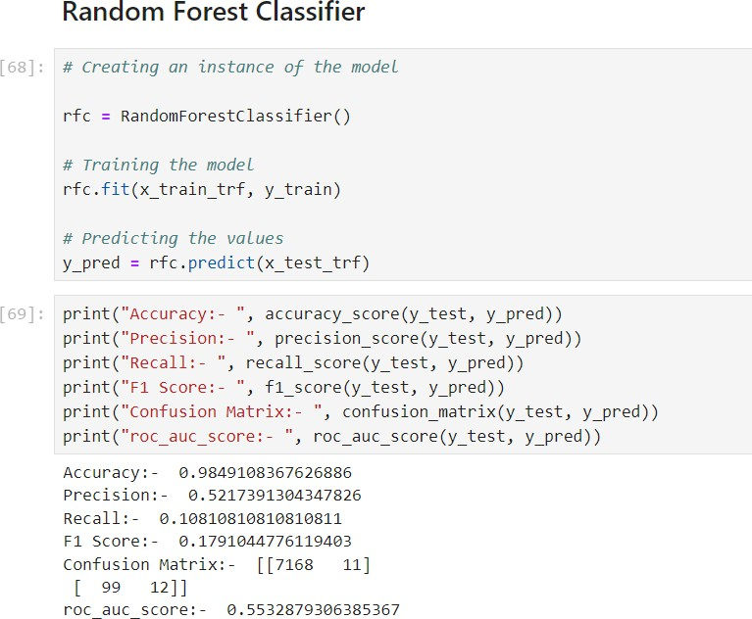
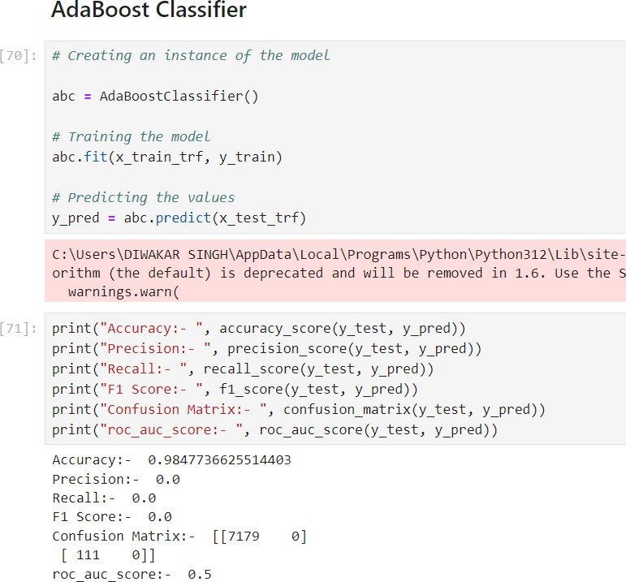
Model Evaluation
Model Evaluation = Assessing how well your model performs on unseen data.

Slide 10

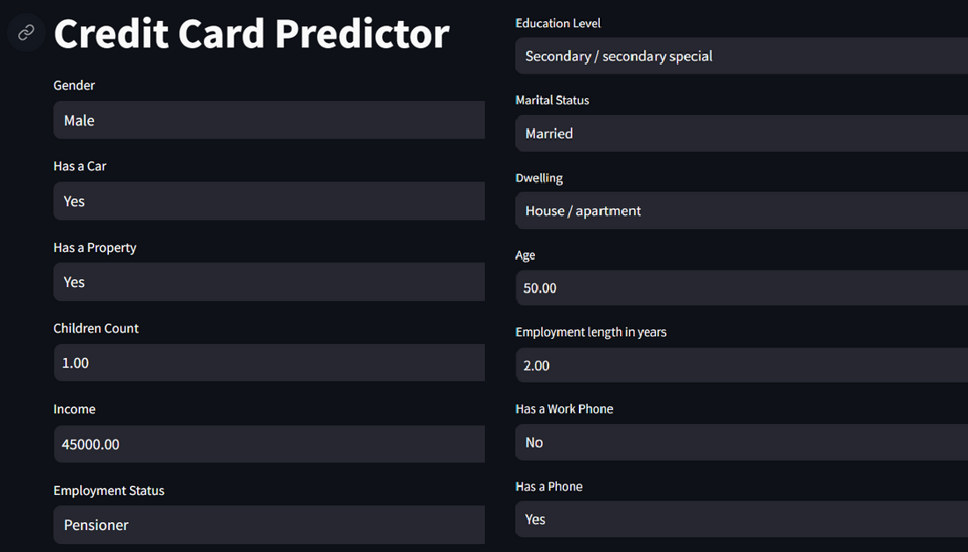
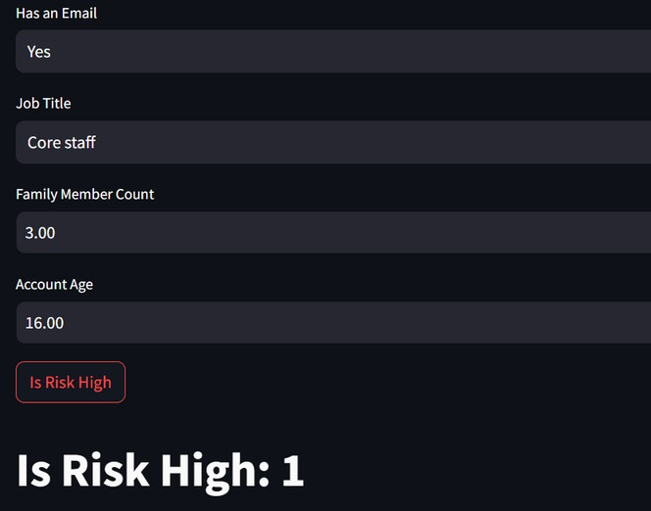
Predicting Credit Card Risk
Creating a Streamlit, web application to show the model performance and test is using an Interactive UI.
Predicting the Risk, here 1 means the risk is high, and 0 means No Risk.

Slide 11
Recommendations
01
02
Targeted Monitoring
Focus resources on applications predicted as high- risk (class 1) by Credit-Card Predictor model.
Tailored Credit Limits
For high-risk but approved applicants, consider offering lower initial credit limits.
03
04
Alternative Products
For high-risk applicants, explore offering alternative credit products with lower limits or secured by collateral to manage risk.
Targeted Communication
For applicants predicted as high-risk (class 1), consider proactive outreach with personalized financial advice or credit management resources

Slide 12

Conclusion
By leveraging Credit Card Model predictions, we can make informed decisions about credit card applications, potentially reducing risk and improving the overall approval process.

Slide 13
Thank You !!!

